Slide 1

Modern Analytics Academy “Vignettes”
Cognitive Services with Synapse ML
https://aka.ms/maa
Chris Mitchell
Principal Cloud Solution Architect

Slide 2
Agenda
Brief Introduction to Synapse ML
Review of Cognitive Services
Demo – AI enabling your Synapse data
Summary & Resources

Slide 3
What is Synapse ML
Open source machine learning library for Spark
Designed to be simple and scalable
Extends Spark ML capabilities with several common ML frameworks
Includes transformers for much of Azure Cognitive Services
Not limited to Synapse, can run anywhere Spark runs
Notes:
When we say “built on top of Apache Spark ml”, this follows a common set of design patterns that are available in spark ml but extends beyond the libraries that ship with Spark.
Another thing to consider is that even though “Synapse” is in the title, this in no way requires Synapse. You can run this in HDInsight, Databricks, a docker container, or anywhere else spark runs.

Slide 4
Agenda
Brief Introduction to Synapse ML
Review of Cognitive Services
Demo – AI enabling your Synapse data
Summary & Resources

Slide 5
Azure Cognitive Services
Prebuilt and customizable models from Microsoft
Targeted to developers and data engineers
Designed to simplify implementation of complex AI tasks
Implemented as APIs so they can be used from anywhere
Notes:
Since the focus of this is how to operationalize Cognitive Services with spark, lets take a quick look at what cognitive services is.
Models can be either be prepackaged, for example sentiment, language detection, speech to text, or customizable, like image classification, forms recognition.
The notion here is to take complex problems that could benefit developers and make them easy to use via accessible rest apis. Now developers don’t need to concern themselves with the complexity of building complex neural networks, and collecting enough training data, but rather implement prebuilt services off the shelf.
As I mentioned, these are implemented as rest apis, so they’re accessible by anything.

Slide 6
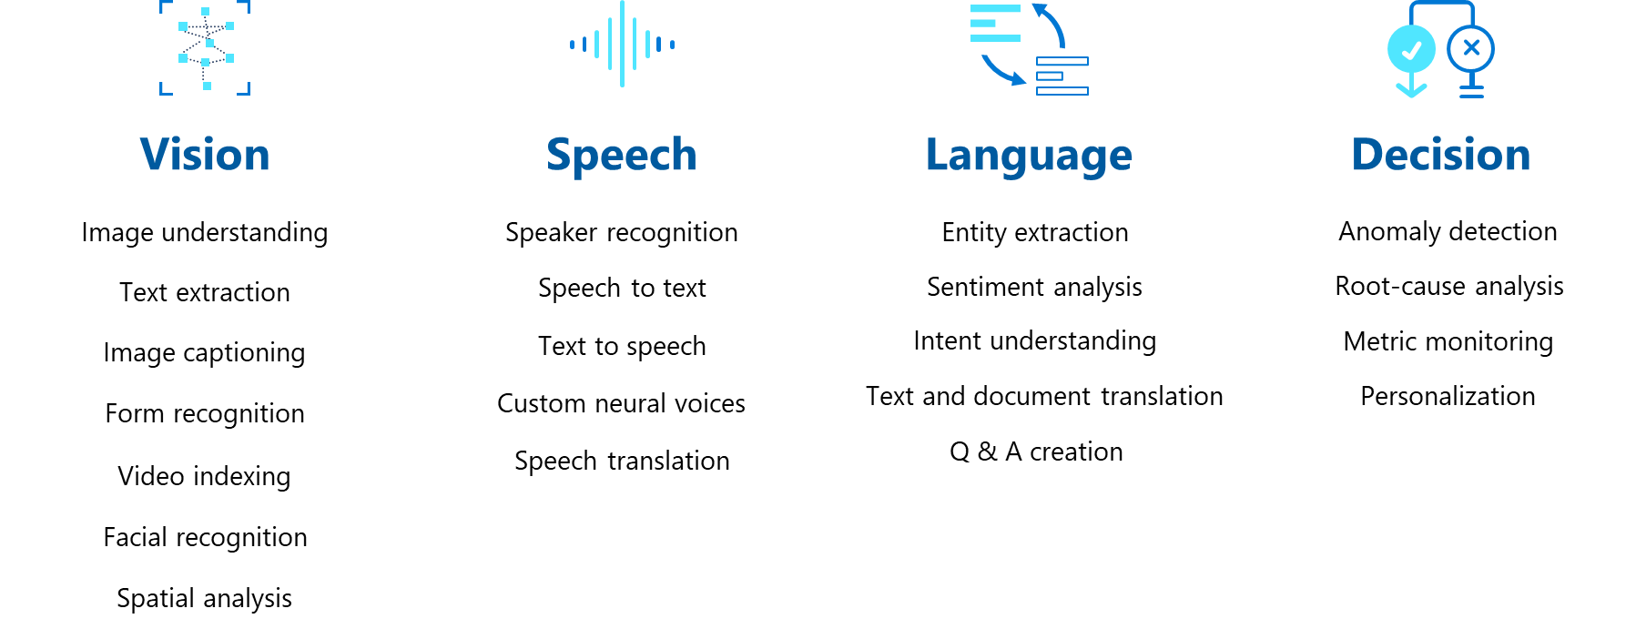
Azure Cognitive Services
Notes:
I’m not going to read this whole slide, but I wanted to share some examples of the types of capabilities we expose in cognitive services to show how rich it is. The Synapse ML libraries cover the majority of cognitive services.

Slide 7
Agenda
Brief Introduction to Synapse ML
Review of Cognitive Services
Demo – AI enabling your Synapse data
Summary & Resources

Slide 8
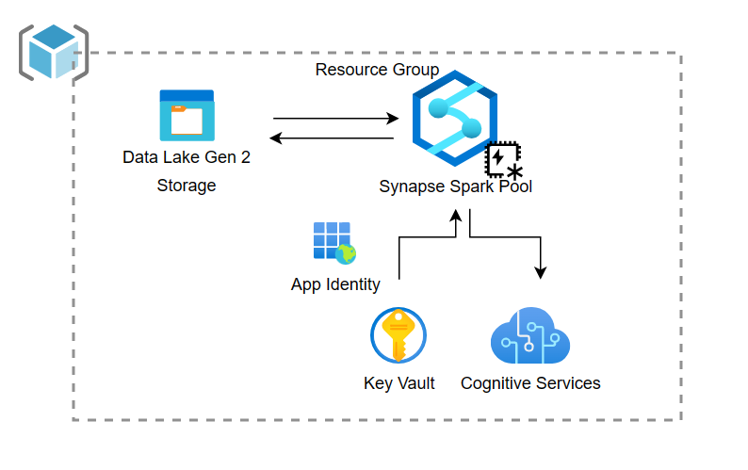
Demo Components
Notes:
Here is the conceptual architecture of this demo. In the interest of time I’ve preprovisioned the resources necessary for this demo and configured them. In the github companion repo for this talk I’ve shared step by step instructions on how to provision this demo in your own environment. A few notable things to point out in this scenario:
Synapse has an application identity that is used to access resources. This is setup for you on your default storage account when you provision a synapse pool, but if you’re using a different storage account you’ll need to grant its identity access to the storage account.
Cognitive services uses a key scheme for authenticating its requests, so we need to store that sensitive information somewhere. While we could have put it in code, that’s not a best practice so we’ve stored it in keyvault.
For synapse to talk to keyvault we must grant its app registration permissions to key vault. In this case we’ve granted it list and get permissions.

Slide 9
Agenda
Brief Introduction to Synapse ML
Review of Cognitive Services
Demo – AI enabling your Synapse data
Summary & Resources

Slide 10
Summary
  Easy to operationalize ML at Scale
  Much more to Synapse ML than just cognitive services
  Can be run anywhere Spark runs

Slide 11
Resources
  SynapseML
    Documentation and Samples: SynapseML | SynapseML (microsoft.github.io)
    Github: microsoft/SynapseML: Simple and Distributed Machine Learning (github.com)
  Cognitive Services in Azure Synapse Analytics - Azure Synapse Analytics | Microsoft Learn
  Azure Cognitive Services documentation | Microsoft Learn
  https://github.com/chmitch/SynapseML-CognitiveServices/ - tutorial and code samples from this session

Slide 12
Thank you!
Modern Analytics Academy “Vignettes”
Cognitive Services with Synapse ML
https://aka.ms/maa

