Slide 1
Modern Analytics Academy
Overview
https://aka.ms/maa

Slide 2
Agenda
Team
Sessions
Digital Transformation trends
Microsoft’s platform for analytics
Demo

Slide 3





Modern Analytics Academy Team
Alex Karasek
Annie Xu
Brian Hitney
Chris Mitchell
Jason Virtue
Senior Cloud Solution Architect
Senior Cloud Solution Architect
Senior Cloud Solution Architect
Principal Cloud Solution Architect
Principal Cloud Solution Architect
https://aka.ms/maa

Slide 4





Academy Sessions
Acquisition & Storage
Modeling
Pipelines
Security & Governance
Visualization
Azure Data Lake
Azure Cosmos DB
Azure Event Hubs
Synapse Link
Data Lake Structure
Synapse Spark Pools
Synapse SQL Pools
Synapse Serverless SQL
Azure Data Factory
Synapse Pipelines
Power BI Dataflows
Azure Stream Analytics
Auditing
Security
Azure purview
Power BI
Paginated Reports
Power BI Embedded
Notes:
Let’s take a quick look at the detailed sessions available.
In Data Acquisition and Storage we’ll look at the nuances of how source systems provide you and the various mechanisms for getting that data into Azure for long term retention and analysis.
In Data Modeling we’ll be looking at how to structure and store your data for the purposes of serving data to applications like reporting tools.
In Data Pipelines we’ll be looking at how to move your data through a data engineering process the prepare the data for serving.
In Data Security and Governance we’ll examine how to deal with topics like controlling access to your data, understanding the lineage of your data and addressing policy compliance on your data.
In Data Visualization we’ll examine how visualization tools can be used to enable users to get timely business value out of your data.

Slide 5



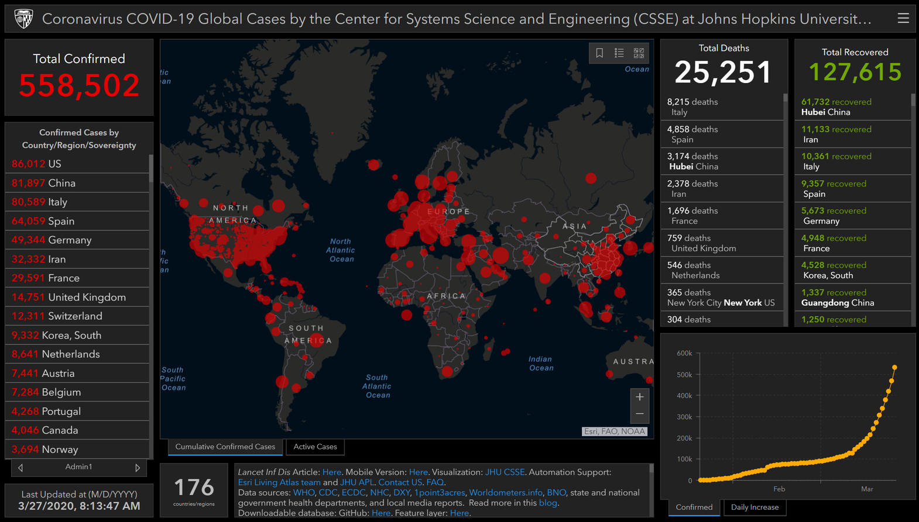
Industry Trends
Digital transformation
is massively accelerating…
Online sales
supercharged
Multi-channel fulfillment
Remote everything
Data
driven
Notes:
Many industries are in the midst of a digital transformation. They’re beginning to use data in new ways and look for new sources of data to help make better informed decisions and get a competitive edge. In essence, businesses have become “data hungry”, and they’re looking to technology to help wrangle and mine value out of these greater volumes of data.

Slide 6
Analytics & AI is the #1 investment for business leaders, however they struggle to maximize ROI
80%
report struggling to become mature users of data*
55%
report data silos and data management difficulties as roadblocks*
* Harvard Business Review (2019), Understanding why analytics strategies fall short for some, but not for others
Notes:
HBR Report: https://azure.microsoft.com/en-us/resources/why-analytics-strategies-fall-short-for-some-but-not-others/
Sadly, in spite of the excitement, investment, and enthusiasm businesses are still struggling with data. In fact, the increase in focus on data has highlighted and perhaps magnified problems that already existed. Lets look at what is contribute to that.

Slide 7
Today’s data Realities
What data do I have?
Is it trustworthy?
Volume
Can people access the data needed
to make the right decisions?
Variety
How can I enable faster
business insights?
Velocity
What’s my compliance exposure?
Notes:
This explosion in data and analytics forced years of “traditional” approaches, namely data warehousing to be rethought. Traditional data warehouse implementations focused on repeatability and consistency. The only data that was kept was data that was specifically attributed to a business requirement. When new requirements were uncovered the time to realize that data in the warehouse hindered business agility.
Enter the world of “big data”. Dealing with data at this volume and speed was often a real challenge for traditional data warehousing processes, and businesses were forced to think differently about this data and handle it in a completely different way. Naturally projects that evolved out of the Hadoop ecosystem were often chosen for these workloads because they tended to be more agile. Today many of these problems are solved using technologies like Spark or managed Spark platforms like DataBricks.
However, even though we’ve come up with new ways to address the “big data” problems we now face, we still have a lot of common challenges we face with the data. How do users find data they’re looking for, how do I ensure the right people have access to the data, how do I ensure the data is correct?

Slide 8
More analytics solutions lead to more silos
Data
Structured
Unstructured
Streaming
Big data
Cloud
On-premises
IoT/edge
Technologies
Map Reduce
Open source projects
Data mart
Data warehouse
Data lake
Spreadsheets
RDMS
Data visualization tools
ML models
AI services
Skills
SQL
Python
Java
R
Industry Schemas
Data modeling
Data cleaning
Data integrations
Notes:
Furthermore, while business are gaining value out of these solutions to “Big Data” problems there is still an inherent burden in this approach because existing data analytics solutions are still in place. Now we find ourselves in a world where there are two different analytics ecosystems the warehouse and the lake. These two ecosystems are often two often owned by two different teams, use different underlying technologies, have different security mechanisms, and have different sets of data. Plus there are integration challenges reconciling and sharing data between these two ecosystems.

Slide 9
Can we realize analytics value with indepent systems
Big Data
Relational Data
Experimentation
Fast exploration
Semi-structured data
Proven security & privacy
Dependable performance
Operational data
OR
Data Lake
Data Warehouse
Notes:
So in this world of multiple analytics technologies solving different niches is there a way to better integrate, better manage while still gaining the inherent value of both approaches?

Slide 10
Synapse brings the warehouse and big data together
Azure Synapse Analytics
Data warehousing & big data analytics—all in one service
Notes:
This is where Azure Synapse comes in. While this may sound like catchy marketing, Synapse is a single service designed to bring these two worlds together. Synapse works with integrated storage, a single security model built on AAD, multiple compute models that can be applied to your data, and an integrated data engineering environment that allows you to orchestrate data process across these compute models. Now you’re no longer limited by the integration points for these two ecosystems.

Slide 11





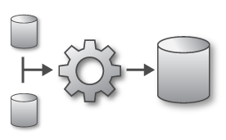

Modern Analytics in Azure
LOB
INGEST
EXPLORE
PREP & TRAIN
MODEL & SERVE
CRM
BI + Reporting
Graph
Advanced Analytics
Query All Data
Analytics Engines
Data Warehouse
Image
Real Time Analytics
Data Orchestration and Monitoring
Social
STORE
Big data store
IoT
METADATA MANAGEMENT & GOVERNANCE
Cloud
Notes:
There’s more to a modern analytics solution than just synapse, but he’s a glimpse at what realizing a modern analytics solution looks like…
Ingestion – we need to be able to connect to the data no matter where it comes from. Line of business applications, cloud services, social networks, sensor networks.
Storage - highly scalable and cost effect storage is critical to these solutions, data lakes make it possible to store theoretically limitless amounts of data making it more about what you decide to throw away than what you keep
Exploration – data processing engines and services are used more for ad hoc data exploration of data
Prep & Train - New analytics and data processing engines such as Spark are being leveraged to prepare data and train models over large data volumes
Model & Serve – Without giving users access to the data to do ad-hoc analysis an analytics solution is useless. We must surface the data in a useable way through modern tools.
Metadata management & governance – with all this data security and regulatory concerns haven’t gone away, data must be discoverable, compliant, and trusted.

Slide 12
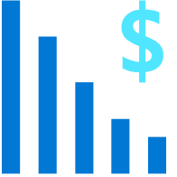




Azure Synapse Analytics: Focus Areas
Best in class price per performance
Industry-leading security
Workload aware query execution
Data flexibility
Developer productivity
Up to 94% less expensive than competitors
Defense-in-depth security and 99.9% financially backed availability SLA
Manage heterogenous workloads through workload priorities and isolation
Ingest variety of data sources to derive the maximum benefit.
Query all data.
Use preferred tooling for SQL data warehouse development
Notes:
While we already had capabilities in several of the solution areas we just looked at, one of the things that is unique about Synapse is how integrated the solution is. As part of this journey we built on our experiences with technologies like Data Factory and SQL Data Warehouse, and focused on making the complete offering that is better integrated than before and better addresses the unique analytics challenges we’ve discussed.

Slide 13
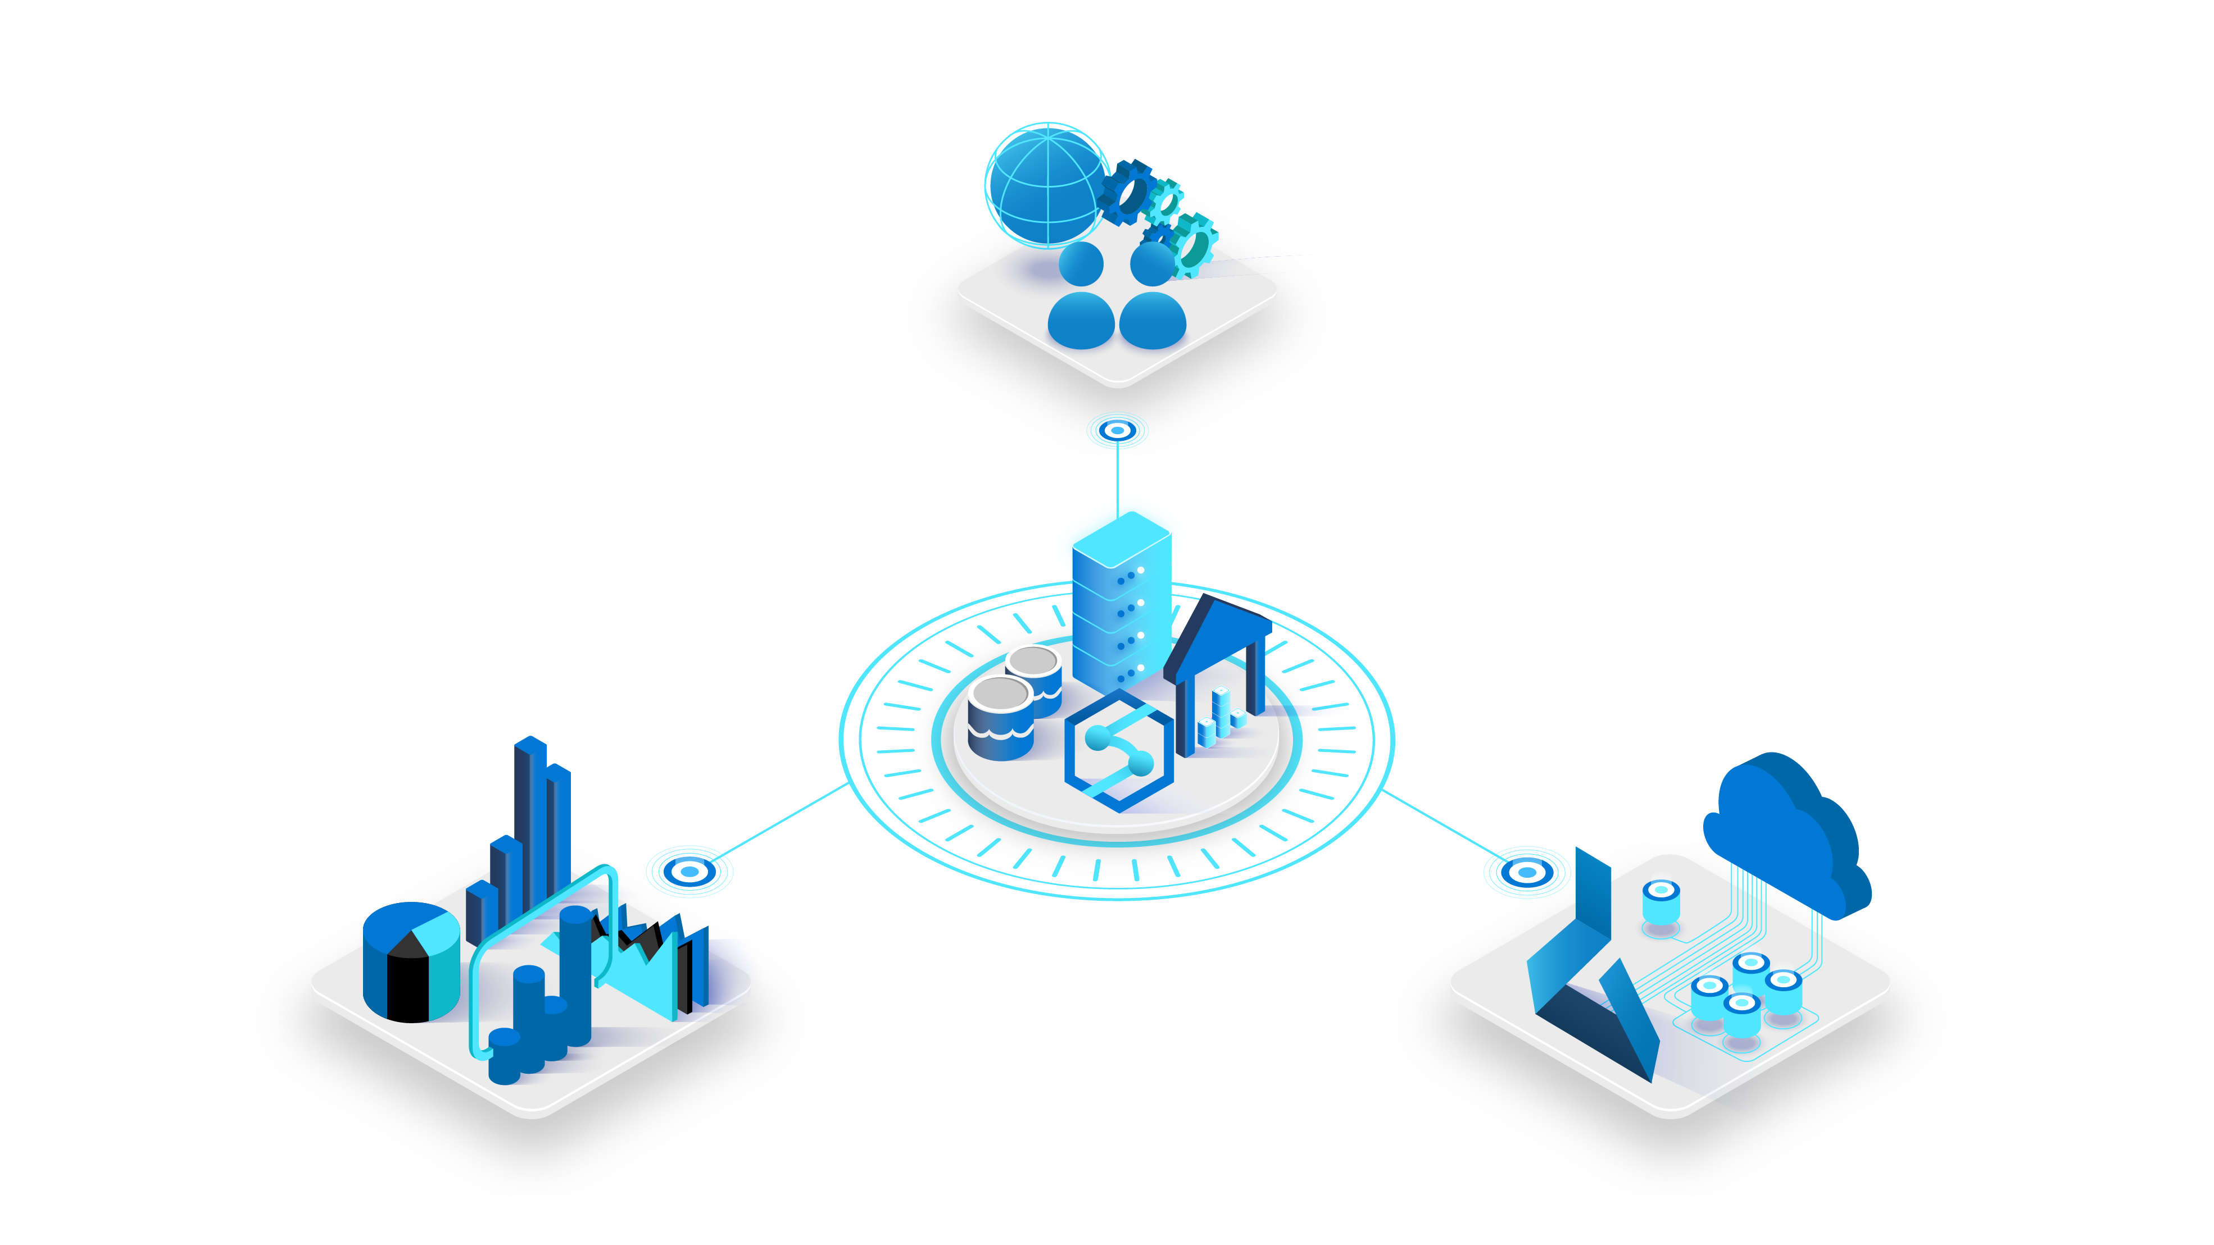
Azure Purview
Azure Synapse Analytics
Power BI
Azure Machine Learning
Notes:
Up until this point we’ve talked mainly about Azure Synapse. I personally like to think about Synapse as the center of the universe for analytics. However, just because it’s the center of the universe there is still a lot of interesting things to discuss as part of complete analytics offering. Technologies like Power BI, Purview and Azure ML. These technologies are all tightly integrated and add value to the overall synapse ecosystem. Let’s take a deeper look…

Slide 14
Azure Purview enables unified data governance
Reimagine data governance in the cloud
Set the foundation for effective data governance
Maximize business value of data for data consumers
Gain insight into data use across the estate
Notes:
Let’s spend a little time looking at Purview. We mentioned earlier that metadata management and governance is a key component of a complete analytics solution. Purview is a new Azure offering designed to address the unique challenges of the hybrid world we live in where data is often across on premises, saas and other cloud providers.

Slide 15
Azure Purview enables unified data governance
Azure Purview
Power BI
SQL Server on-prem
Azure Synapse
Azure Data Services
M365 Compliance Center
Unified Experience
Data Catalog
Data Insights
Search
Business Glossary
Lineage
Data use reports
Publish, Discover & Curate Data
Unified Platform
“Data Map” = Data Assets | Lineage | Classifications
Open APIs
Automated Scanning & Classification
(Apache Atlas 2.0)
On-prem & Multi-cloud Operational, Analytical, SaaS
Notes:
Maximize business value of data with Azure Purview, a unified data governance solution, across operational and transactional data. Enable business and technical analysts to find, interpret and trust data with an intuitive catalog. Get insights and ensure data usage is governed within compliance guardrails.
Azure Purview is a unified data governance service. It organizes vast metadata that enables organizations to break down silos and derive meaning from data. Once data can be understood and annotated, it then lends itself to several applications – the first of which, we announced at public preview, being data catalog and data insights. In the future, privacy, quality and master data management value will follow.

Slide 16

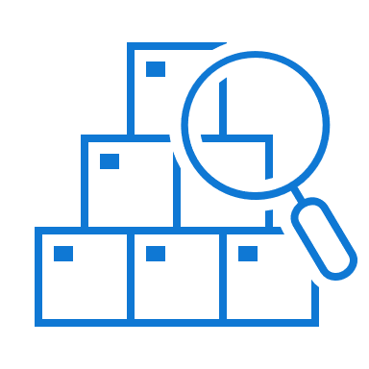

Purview + Synapse + Power BI: Better Together
Discover
Browse and Search
Enhanced metadata, lineage, sensitivity labels & endorsements
Register Synapse workspaces with Purview
Discover Power BI assets (tenant, workspace level) in Purview Catalog
Search datasets in Synapse workspaces from linked Purview catalog
Find Power BI assets (dashboards, reports, datasets etc.) in Purview catalog
View enhanced metadata, lineage from Purview for Synapse tables and add annotations
View enhanced metadata, lineage, sensitivity labels, endorsement labels in Purview for Power BI assets

Slide 17

Azure Machine Learning
Democratize predictive power
Synapse makes predictive analytics accessible to all
Notebooks provides a code authoring experience for complex predictive models
Automatic ML graphical interface provides a no-code experience for creating ML models
Native integration with Azure Cognitive Search provides access to pre-built models
All Code
Notebook IDE
PySpark/Scala
Low/no-Code
Classification
Regression
Time-series
Pre-built models
Anomaly Detector
Sentiment Analysis
Notes:
Now your data engineers and data scientists can collaborate seamlessly, using code free and code first experiences to train ML models in Synapse, powered by Azure Machine Learning. Notebooks offer a collaborative, code authoring experience for complex predictive models.
Whether you use our pre-built models or build your own, automated machine learning takes minutes on Azure Synapse, versus days or months, so you can iterate rapidly for greater insights.

Slide 18




Power BI + Synapse: Better Together
Visualize
and report
Model
& serve
Save money with
industry-leading performance
Azure Synapse Analytics is up to 14x faster and 94% cheaper than other cloud providers
View reports with
a single pane of glass
Skip the configuration when connecting to Power BI with integrated Power BI-authoring directly in the Azure Synapse Studio
Respond instantly
Enable instant response times with Power BI Aggregations on massive datasets when querying at the aggregated level
Get granular with your data
Queries at the granular level are sent to Azure Synapse Analytics with DirectQuery leveraging its industry-leading performance
Power BI
Azure Synapse Analytics
SQL Databases
Data Lake
Notes:
Power BI and Azure Synapse unlock big data in a way that would otherwise be impossible. Businesses with the ever increasing volumes of data need ways to query across these large volumes of data to derive value. Power BI and Synapse work in concert to solve these big data problems by playing to each others strengths. Users can get fast answers over large sets of data while still having the ability to drill into the granular details.

Slide 19
Maximize ROI with
Azure Synapse Analytics and Power BI
271% Average ROI
60%
Increased customer satisfaction
27%
Faster time to insights
26%
Lower total cost of ownership
* Forrester, October 2019, “The Total Economic Impact of Microsoft Azure Analytics with Power BI”
Notes:
Forrester report: https://azure.microsoft.com/en-us/resources/forrester-tei-microsoft-azure-analytics-with-power-bi/

Slide 20

Demo:
A tour of Azure Synapse

Slide 21

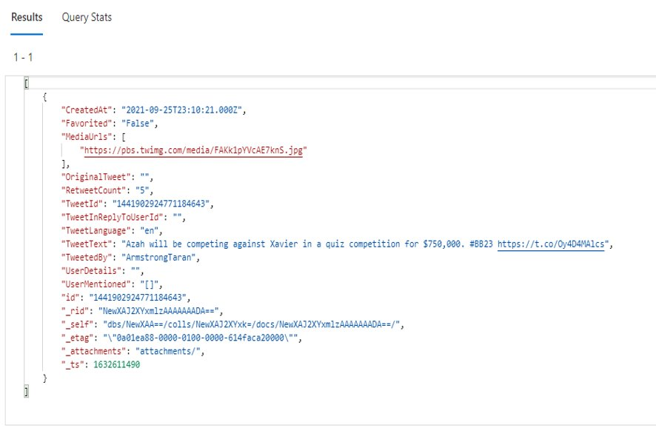
Demo: Business Problem

Slide 22
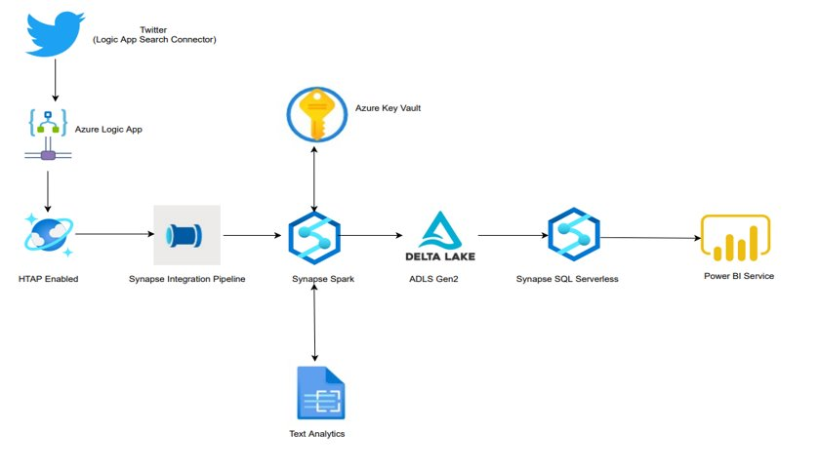
Demo: Architecture

Slide 23
Thank you

