Slide 1
Modern Analytics Academy
Modeling
https://aka.ms/maa

Slide 2
Agenda
What is Modern Analytics Academy?
The Team​
Modern Analytics in Azure
Model & Serve
  Data Lake Structure
  Synapse as solution
  Demo
  Review
Notes:
The agenda for today’s session will include:
A review of the modern analytics academy framework
The team behind it
An overview of a modern analytics architecture in Azure
Finally a deep dive into ways to model and serve data in Azure. Specific topics covered will include data lake structures for analytical use cases, how synapse fits as a solution and a demo of these concepts

Slide 3





Modern Analytics Academy Team
Alex Karasek
Annie Xu
Brian Hitney
Chris Mitchell
Jason Virtue
Senior Cloud Solution Architect
Senior Cloud Solution Architect
Senior Cloud Solution Architect
Principal Cloud Solution Architect
Principal Cloud Solution Architect
https://aka.ms/maa
Notes:
The MAA was built to show breadth and depth of capabilities in Azure that can be used to implement a Modern Analytics Solution in the cloud. This is the team behind this program, and we are all Cloud Solution Architectes on Microsoft’s Global Partner Solutions Team.

Slide 4
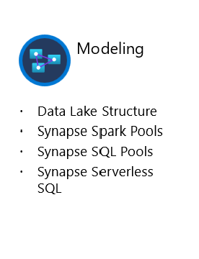





Academy Sessions
Acquisition & Storage
Modeling
Pipelines
Security & Governance
Visualization
Azure Data Lake
Azure Cosmos DB
Azure Event Hubs
Synapse Link
Data Lake Structure
Synapse Spark Pools
Synapse SQL Pools
Synapse Serverless SQL
Azure Data Factory
Synapse Pipelines
Power BI Dataflows
Azure Stream Analytics
Auditing
Security
Azure purview
Power BI
Paginated Reports
Power BI Embedded
Notes:
Let’s take a quick look at the detailed sessions available.
In Data Acquisition and Storage we looked at the nuances of how source systems provide data and the various mechanisms for getting that data into Azure for long term retention and analysis.
In Data Modeling we’ll be looking at how to structure and store your data for the purposes of serving data to applications like reporting tools.
In Data Pipelines we’ll be looking at how to move your data through a data engineering process and prepare the data for serving.
In Data Security and Governance we’ll examine how to deal with topics like controlling access to your data, understanding the lineage of your data and addressing policy compliance on your data.
In Data Visualization we’ll examine how visualization tools like Power BI can be used to enable users to get timely business value out of your data.

Slide 5
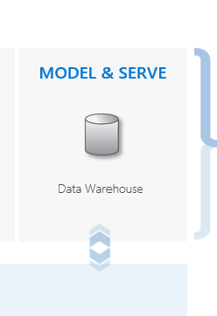





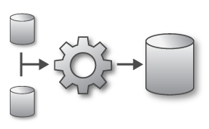

Modern Analytics in Azure
LOB
INGEST
EXPLORE
PREP & TRAIN
MODEL & SERVE
CRM
BI + Reporting
Graph
Advanced Analytics
Query All Data
Analytics Engines
Data Warehouse
Image
Real Time Analytics
Data Orchestration and Monitoring
Social
STORE
Big data store
IoT
METADATA MANAGEMENT & GOVERNANCE
Cloud
Notes:
Ingestion – we need to be able to connect to the data no matter where it comes from. Line of business applications, cloud services, social networks, sensor networks as well as being able to support the different cadences with which that data arrives.
Storage - highly scalable and cost effect storage is critical to these solutions, with theoretically limitless amounts of data being required to support these types of solutions, choosing the right methods for storage is always critical
Exploration – data processing engines and services are used more for ad hoc data exploration of data
Prep & Train - New analytics and data processing engines such as Spark are being leveraged to prepare data and train models over large data volumes
Model & Serve – Without giving users access to the data to do ad-hoc analysis an analytics solution is useless. We must surface the data in a useable way through modern tools.
Metadata management & governance – with all this data security and regulatory concerns haven’t gone away, data must be discoverable, compliant, and trusted.

Slide 6
Role of Data in Modern Analytics
Big Data
Relational Data
Experimentation
Fast exploration
Semi-structured data
Proven security & privacy
Dependable performance
Operational data
OR
Data Lake
Data Warehouse
Notes:
Data is fundamental to the types of modern analytics solutions that we are discussing in this series. When it comes to data at this scale there are generally 2 ways to store, model, and serve to consumes. Data Lakes are generally ideal for experimentation, exploratory, or ad hoc queries over semi-structured data at any scale. For more traditional analytics and reporting scenarios, a DW is often more suitable for serving data via a relational data model with proven security and dependable performance over aggregated operational data sets.

Slide 7
Role of Data in Modern Analytics
Azure Synapse Analytics
Azure Synapse Analytics
Data warehousing & big data analytics—all in one service
Data warehousing & big data analytics—all in one service
Notes:
By being able to support both scenarios, Synapse Analytics becomes the natural hub for all of your modern analytical solutions

Slide 8

Introducing Azure Synapse Analytics
A limitless analytics service with unmatched time to insight, that delivers insights from all your data, across data warehouses and big data analytics systems, with blazing speed
Simply put, Azure Synapse is Azure SQL Data Warehouse evolved
We have taken the same industry leading data warehouse and elevated it to a whole new level of performance and capabilities

Slide 9
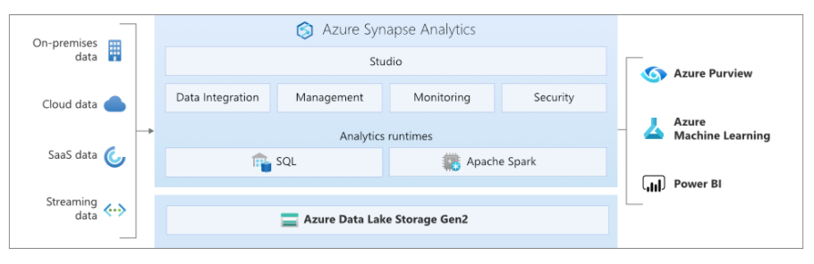
Azure Synapse Analytics
Notes:
Designed for analytics workloads at any scale
Interfaces:
Synapse Studio – web based portal for object exploration, data engineering, development, orchestration all through a single pane of glass
SaaS developer experiences for code free and code first
Multiple languages suited to different analytics workloads
Integrated analytics runtimes available provisioned and serverless on-demand
SQL Analytics offering T-SQL for batch, streaming and interactive processing
Spark for big data processing with Python, Scala, R and .NET
Integrated platform services
for, management, security, monitoring, and metastore
Data lake integrated and Common Data Model aware

Slide 10
Key Terms
Data Lake
A data lake is a storage repository that holds a large amount of data in its native, raw format. Data lake stores are optimized for scaling to terabytes and petabytes of data. The data typically comes from multiple heterogeneous sources, and may be structured, semi-structured, or unstructured. The idea with a data lake is to store everything in its original, untransformed state. This approach differs from a traditional data warehouse, which transforms and processes the data at the time of ingestion.
Azure Data Lake (ADLS Gen 2)
Data Lake Storage Gen2 makes Azure Storage the foundation for building enterprise data lakes on Azure
Data Warehouse (DW)
A data warehouse is a centralized repository of integrated data from one or more disparate sources. Data warehouses store current and historical data and are used for reporting and analysis of the data.
Logical Data Warehouse (LDW)
A relational layer built on top of Azure data sources such as Azure Data Lake storage (ADLS Gen 2), Azure Cosmos DB analytical storage, or Azure Blob storage

Slide 11
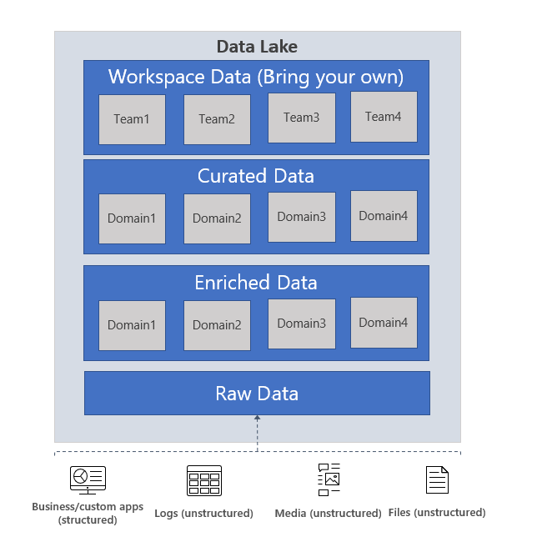
ADLS Gen 2
Notes:
Raw data: This is data as it comes from the source systems. This data is typically ingested in raw format via automated streaming or batch oriented pipelines and is consumed by an analytics engine such as Spark or managed integration pipelines in ADF or Synapse to perform cleansing and enrichment operations to generate the enriched and curated data. Common formats might include csv or JSON which are optimized for efficient write operations
Enriched data: This layer of data is the version where raw data (as is or aggregated) has a defined schema and also, the data is cleansed, enriched (with other sources) and is available to analytics engines to extract high value data. Data engineers generate these datasets and also proceed to extract high value/curated data from these datasets. Data in this zone might be stored in a format such as parquet which is compressed and includes schema which makes it much more suitable for read heavy and analytical workloads.
Curated data: This layer of data contains the high value information that is served to the consumers of the data – the BI analysts and the data scientists. This data has structure and can be served to the consumers either as is in its native format or through a more traditional data warehouse. Data assets in this layer is usually highly governed and well documented. Data in this zone might be stored in a format like delta which is an enhanced version of parquet that leverages a transaction log to enable advanced capabilities like merge operations, time travel, and significantly better performance when using for analytical queries

Slide 12
Azure Synapse Analytics
Rich surface area
T-SQL language for data analytics
dedicated SQL pool
Model raw files as virtual tables and views
Easy data transformation
Supporting large number of languages and tools
serverless SQL pool
Indexing and caching
Modern Data Warehouse
Querying external data
Workload management
Import and query external data
Enterprise-grade security

Slide 13





Azure Synapse Analytics
Dedicated SQL Pools (Formerly SQL DW)
Best in class price per performance
Industry-leading security
Intelligent workload management
Data flexibility
Developer productivity
Up to 94% less expensive than competitors
Defense-in-depth security and 99.9% financially backed availability SLA
Prioritize resources for the most valuable workloads
Ingest variety of data sources to derive the maximum benefit
Use preferred tooling for SQL data warehouse development

Slide 14
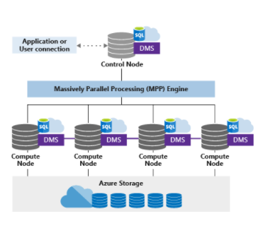
Azure Synapse Analytics
Dedicated SQL Pools
Advanced storage system
        Columnstore Indexes
        Table partitions
        Distributed tables
        Isolation
        Materialized Views
        Nonclustered Indexes
        Result-set caching
T-SQL Querying
        Windowing aggregates
        Approximate execution (Hyperloglog)
        JSON data support
        Score machine learning models in ONNX format
Complete SQL object model
        Tables
        Views
        Stored procedures
        Functions

Slide 15
Azure Synapse Analytics
Serverless SQL Pools
Quick data exploration
Easily explore schema and data in files on Azure storage
Logical Data Warehouse
Model raw files as virtual tables and views
Easy data transformation
Transform CSV to parquet format
Move data between containers and accounts
Use any tool that works with SQL to analyze files
Use enterprise-grade security model
Save the results of queries on external storage
Supports various file formats (Parquet, CSV, JSON)
Direct connector to Azure storage for large BI ecosystem
Notes:
An interactive query service that enables you to use standard T-SQL queries over files in Azure storage.

Slide 16
Azure Synapse Analytics
Apache Spark Pools
An unified, open source, parallel, data processing framework for Big Data Analytics
  Spark Unifies:
  Batch Processing
  Interactive SQL
  Real-time processing
  Machine Learning
  Deep Learning
  Graph Processing
Spark SQL
Batch processing
Spark MLlib
Machine
Learning
Spark
Streaming
Stream processing
GraphX
Graph
Computation
Spark Core Engine
Yarn
Spark MLlib
Machine
Learning
Notes:
Having Spark integrated directly inside of Synapse allows users to pick the appropriate query engine for every scenario without ever needing to leave the Synapse workspace environment. Because the available Hive metastore is automatically synced with SQL Serverless engine, data can be directly integrated across platforms, and because it is embedded directly inside of Synapse, that means that all of the associated benefits such as security, administration, monitoring, etc… would apply. Some supported use cases that are made easier through the use of this embedded engine include:
Batch Processing
Interactive SQL
Real-time processing
Machine Learning
Deep Learning
Graph Processing

Slide 17

Demo:
A tour of Azure Synapse

Slide 18
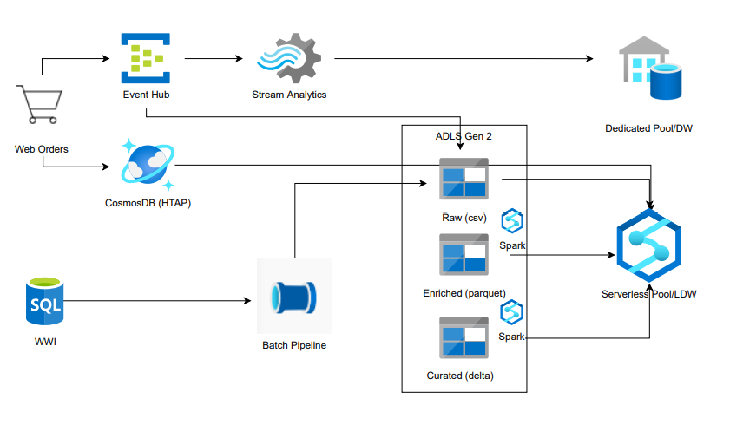
Demo Architecture

Slide 19
Thank you

